Slide 1
Uber Supply-Demand Gap Analysis
Rahul Shukla

Slide 2
Objectives & Goals of Analysis
Business Objectives:
The objective is to identify reasons for non-availability and cancellation of cabs during various hours of the day. Any recommendations to improve the demand-supply gap would be made.
Goals of Analysis:
Identify critical problems in availability/ cancellation resulting in declined customer experience .
Demand-Supply Gap analysis- Understand reasons for demand supply gap
Recommendations- Possible solutions to mitigate the gap

Slide 3
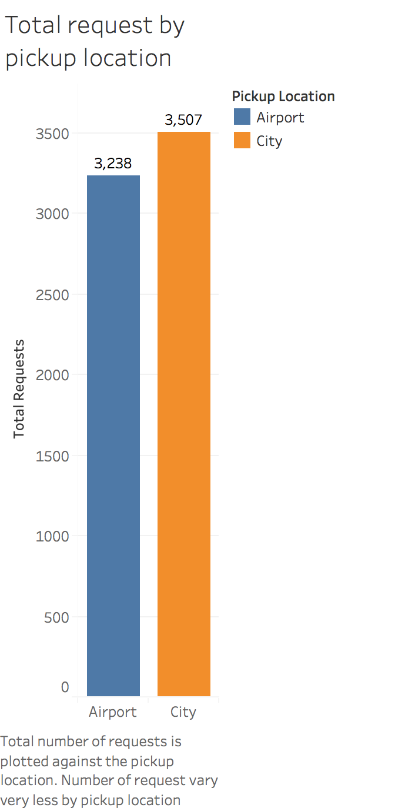
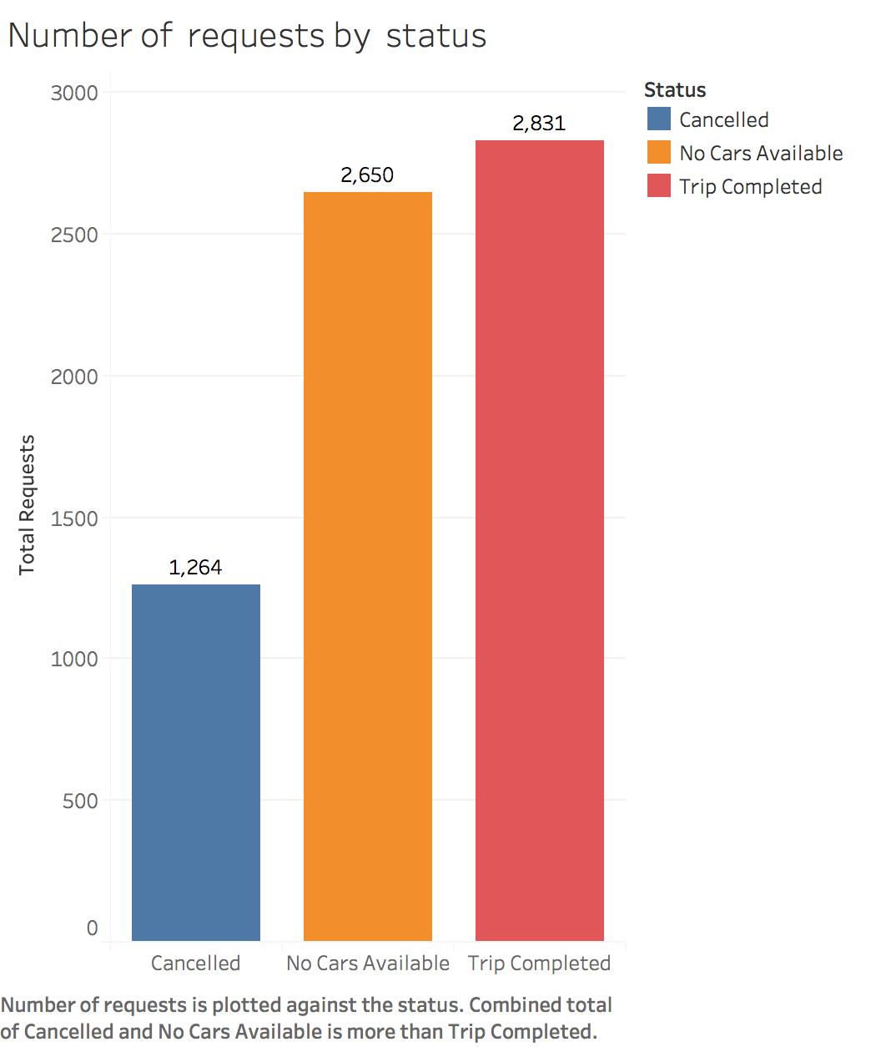
Analysis by single variable

Slide 4
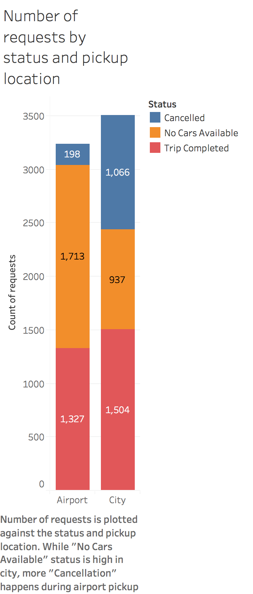
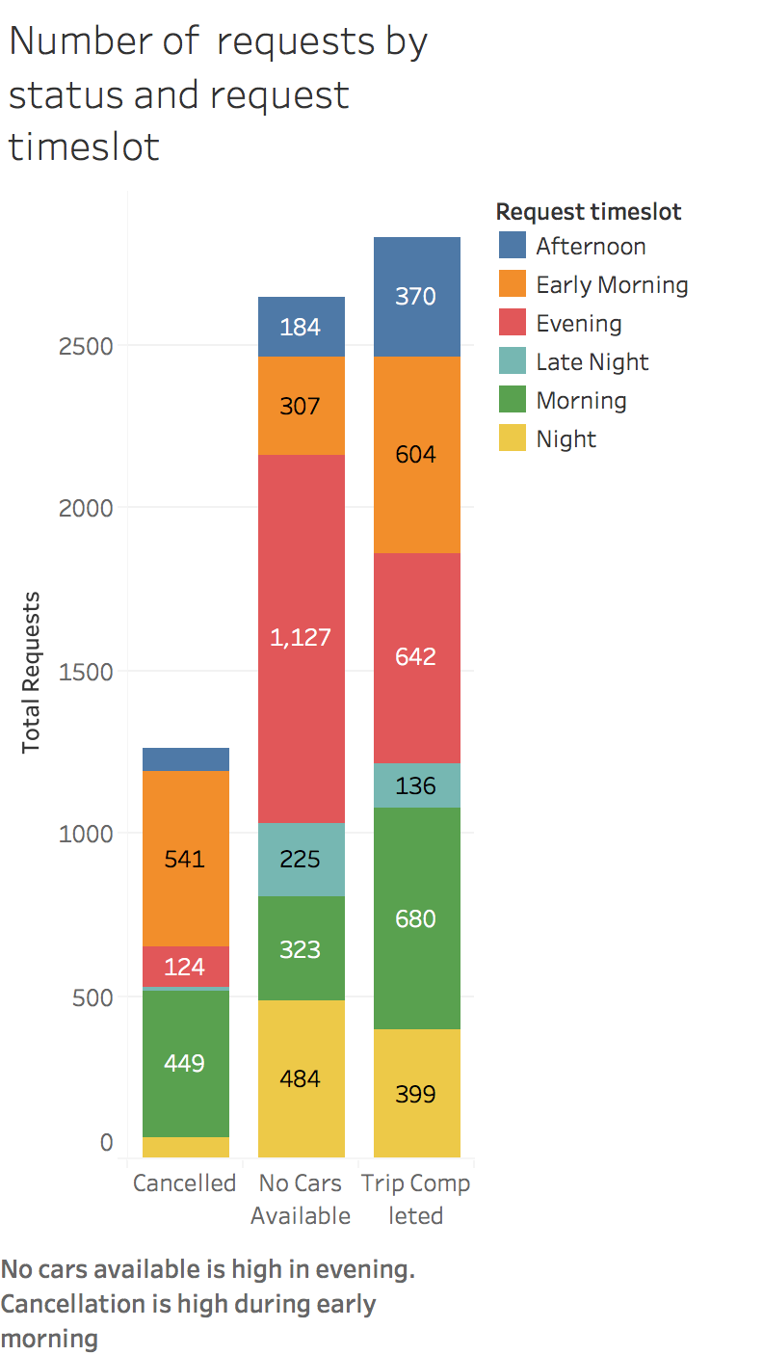
Analysis by timeslot and location

Slide 5
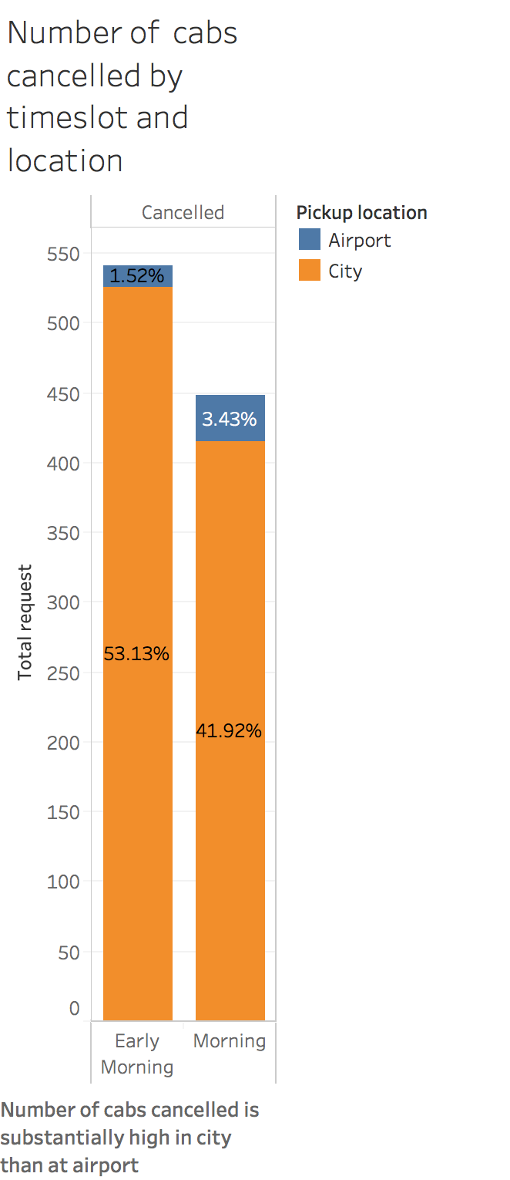
Outcome analysis -1
Analysis Results:
Number of cabs cancelled is high during early morning (3AM-7AM) and morning (7AM-12:00PM)
95% of cabs cabs cancelled are for city pickup.
Reason of high cancellation:
The median of duration of the journey is high from city in this time slot.
The frequency of passengers taking cab from airport is high during evening. Hence the wait time would be very high at the airport.

Slide 6
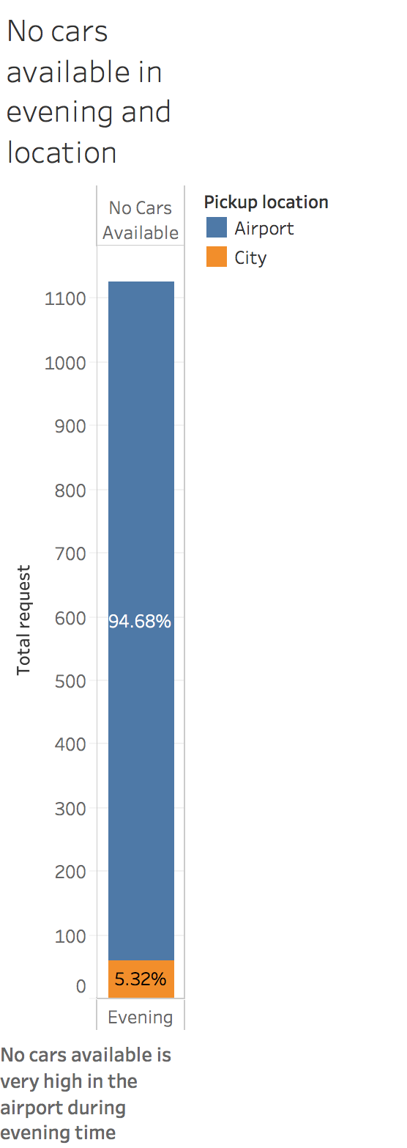
Outcome analysis -2
Analysis Results:
No cars available is high during evening time (4PM-8PM)
95% of cabs not available are from airport pickup.
Reason of high cancellation:
Evening is the most preferred time of landing and hence number of requests from the airport is highest during evening.
Since no cabs have reached to the airport earlier from the city ( due to high cancellation),the supply of the cab is much lower than the demand.

Slide 7
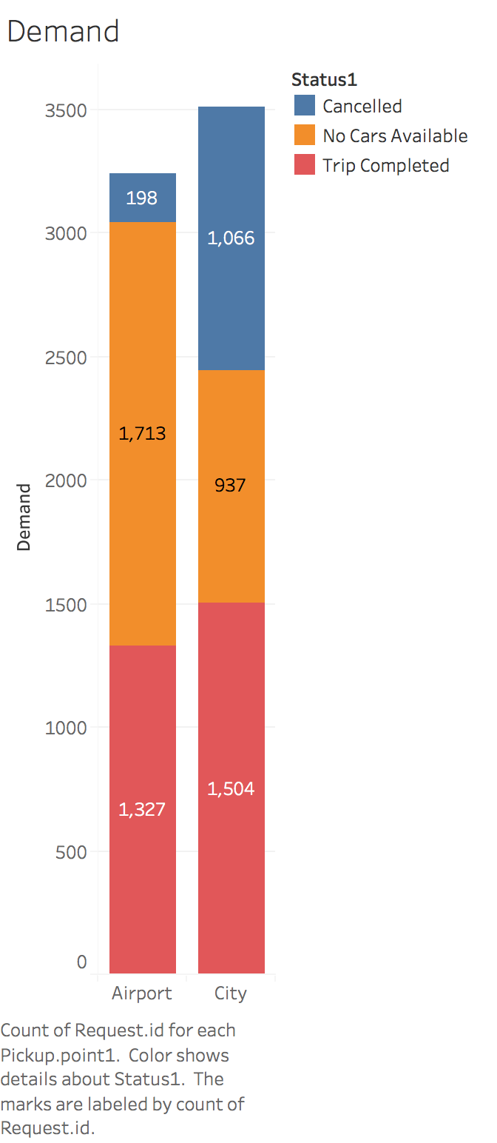
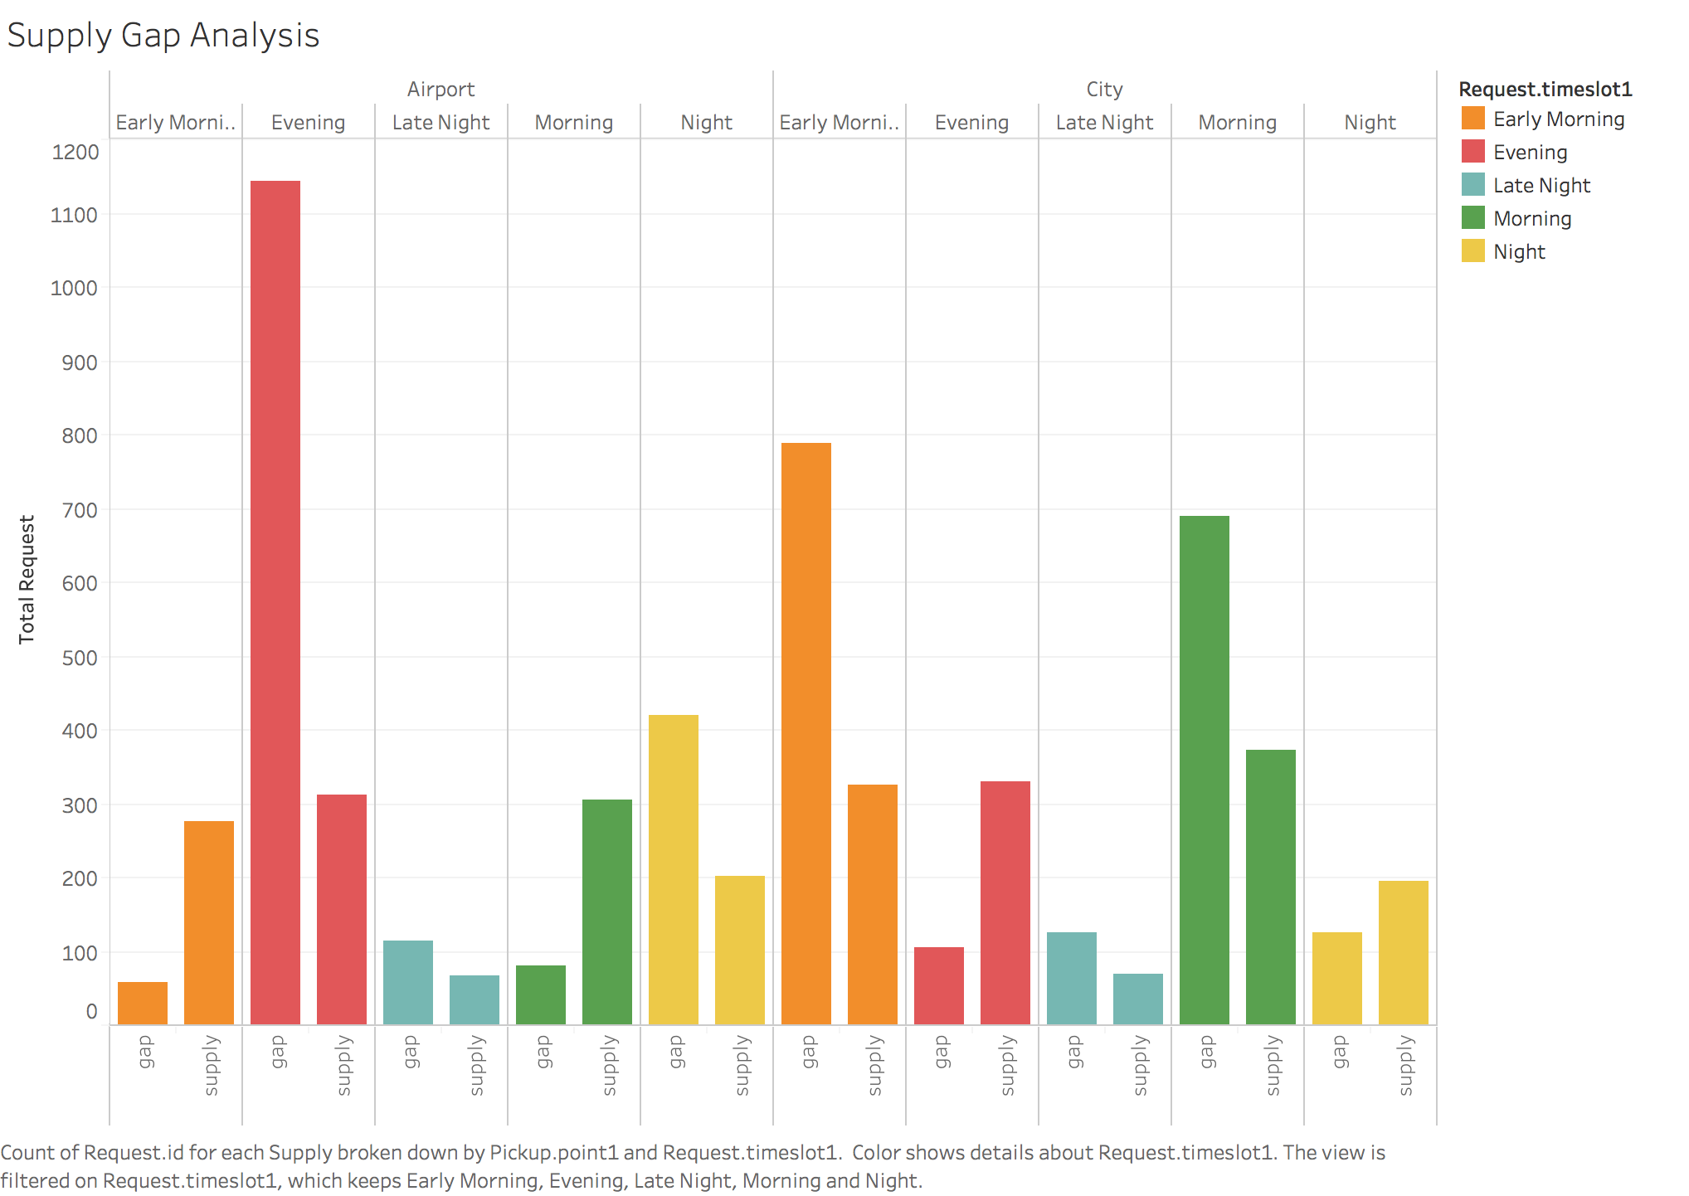
Supply Demand Gap Analysis

Slide 8
Conclusion
Gap is higher than supply for
Early morning and morning for city pickup
Evening for airport pickup
High morning traffic due to office and schools results in high median of travel time to the airport.
Low airport pickup demand results in high wait time at the airport.
Lesser cabs reaching airport by evening results in low supply at increased demand time slot.

Slide 9
Recommendations
Encourage pooling of riders to the airport. This would ensure a larger combined income to the driver.
Incentivize the drivers opting for morning pickup to the airport by providing monetary benefits.
Reduce wait time at the airport. Encourage drivers to leave the airport w/o passenger after a minimum wait time. Till the driver gets a passenger in the city, a monetary incentive can be added.
Drivers staying near the airport would have higher incentive to take the trips. More such drivers can be hired.
Number of cabs at the airport in the evening should be increased to maximize returns.

